Slide 1
Topic: Percentages
EQ: How do I Convert Fractions, Decimals and Percentages.
Glue in the conversion chart

Slide 2
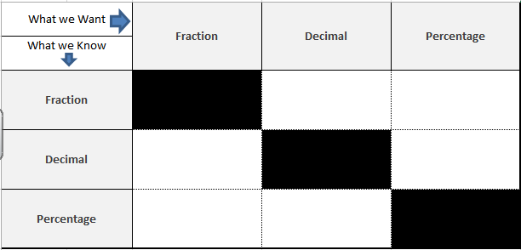

Conversion help sheet
Numerator ÷ Denominator
(Bus-stop method)
Create an equivalent fraction with a denominator of 100
Use knowledge of place value.
0.23 (the 3 is 3 hundredths = $\frac{23}{100})$
X 100
(Multiply by 100)
÷ 100
(Divide by 100)
Put over 100 and then simplify

Slide 3
Conversion help sheet

Slide 4
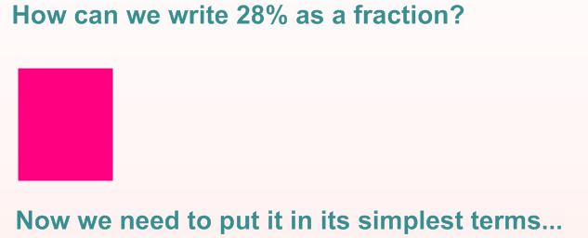
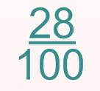
Percentages to Fractions

Slide 5
Conversion help sheet
Put over 100 and then simplify

Slide 6
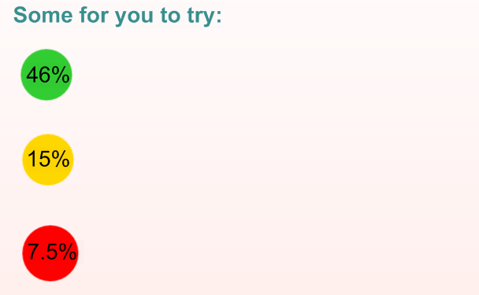

Slide 7
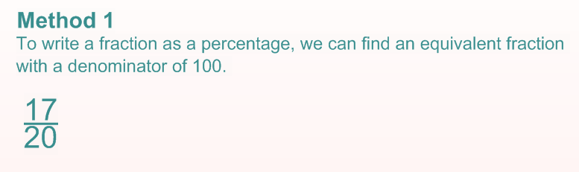
Fraction to a Percentage

Slide 8
Conversion help sheet
Create an equivalent fraction with a denominator of 100
Put over 100 and then simplify

Slide 9
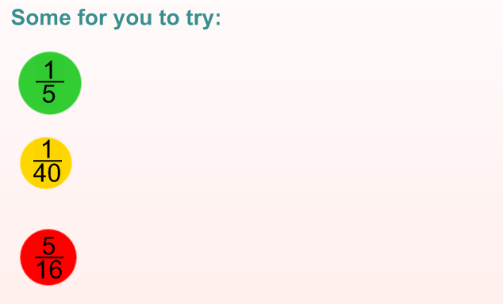

Slide 10
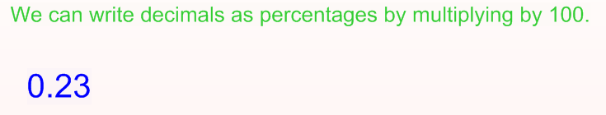
Decimal to a Percentage

Slide 11
Conversion help sheet
Create an equivalent fraction with a denominator of 100
X 100
(Multiply by 100)
Put over 100 and then simplify

Slide 12
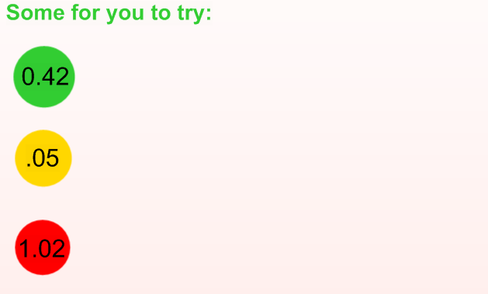

Slide 13
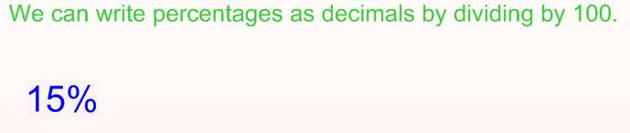
Percentage to a Decimal

Slide 14
Conversion help sheet
Create an equivalent fraction with a denominator of 100
X 100
(Multiply by 100)
÷ 100
(Divide by 100)
Put over 100 and then simplify

Slide 15
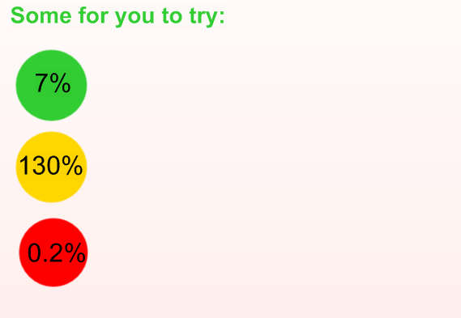

Slide 16
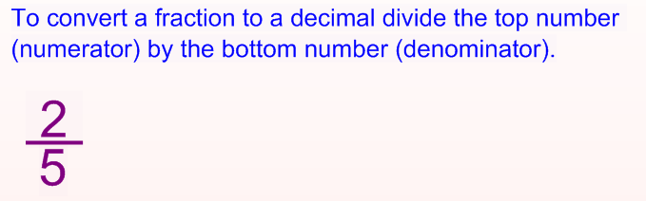
Fraction to a Decimal

Slide 17
Conversion help sheet
Numerator ÷ Denominator
(Bus-stop method)
Create an equivalent fraction with a denominator of 100
X 100
(Multiply by 100)
÷ 100
(Divide by 100)
Put over 100 and then simplify

Slide 18
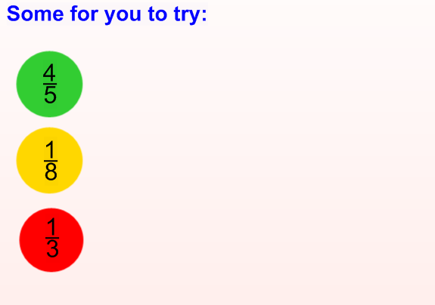

Slide 19
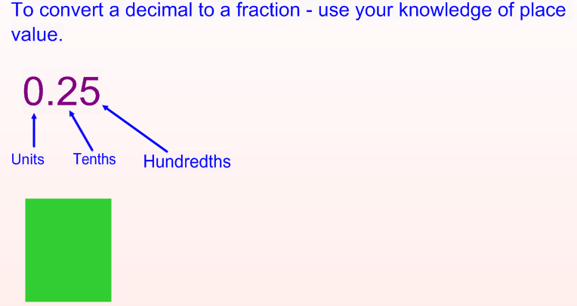

Decimal to a Fraction

Slide 20

Conversion help sheet
Numerator ÷ Denominator
(Bus-stop method)
Create an equivalent fraction with a denominator of 100
Use knowledge of place value.
0.23 (the 3 is 3 hundredths = $\frac{23}{100})$
X 100
(Multiply by 100)
÷ 100
(Divide by 100)
Put over 100 and then simplify

Slide 21
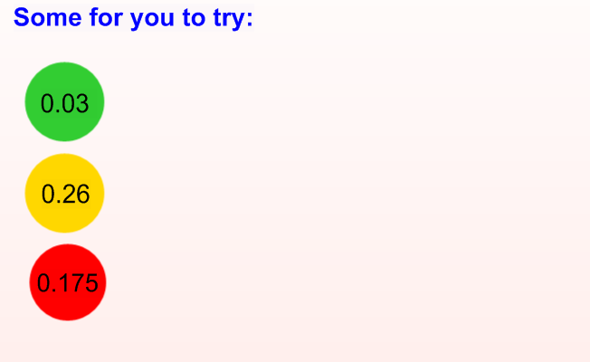

Slide 22
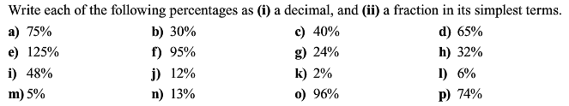
Percentages Conversions i) Turn into a decimal ii) Turn into a fraction and simplify

Slide 23
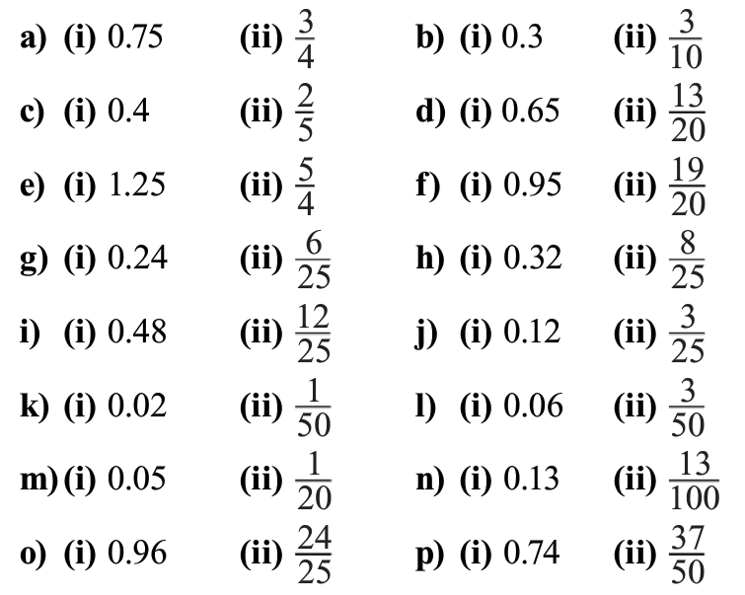
Answers

Slide 24
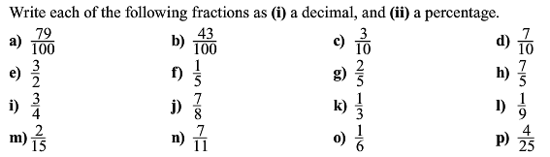
Fractions Conversions i) Turn into a decimal ii) Turn into a percentage

Slide 25
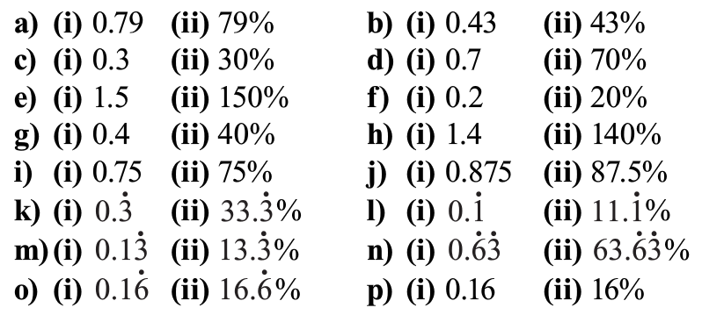
Answers

Slide 26
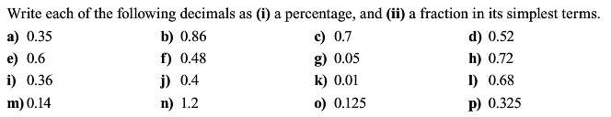
Decimals Conversions i) Turn into a percentage ii) Turn into a fraction and simplify

Slide 27
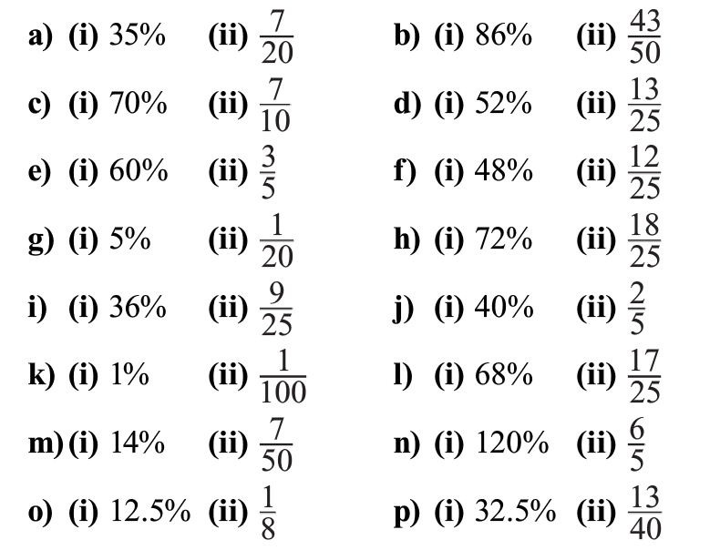
Answers

Slide 28
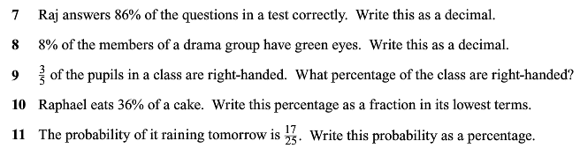
Worded Questions

Slide 29
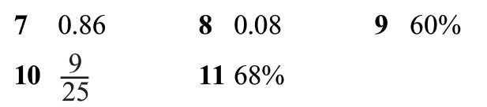
Answers

Slide 30
Students sheets

Slide 31
Conversion help sheet
Numerator ÷ Denominator
(Bus-stop method)
Create an equivalent fraction with a denominator of 100
Use knowledge of place value.
0.23 (the 3 is 3 hundredths = $\frac{23}{100})$
X 100
(Multiply by 100)
÷ 100
(Divide by 100)
Put over 100 and then simplify

Slide 32
Percentages to Fractions

Slide 34
Fraction to a Percentage

Slide 36
Decimal to a Percentage

Slide 38
Percentage to a Decimal

Slide 40
Fraction to a Decimal

Slide 42
Percentages Conversions i) Turn into a decimal ii) Turn into a fraction and simplify

Slide 43
Fractions Conversions i) Turn into a decimal ii) Turn into a percentage

Slide 44
Decimals Conversions i) Turn into a percentage ii) Turn into a fraction and simplify

Slide 45
Worded Questions

